Slide 1
Sean Koppenhafer, Jaime Rodriguez,
Chad Thueson, Noah Erickson, Rishal Dass
Weekly meeting, 05/20/2015
Digital Dash
Portland State University
Department of Electrical and Computer Engineering (ECE)
Notes:
1
1

Slide 2
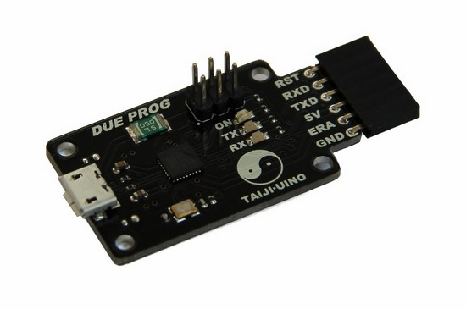
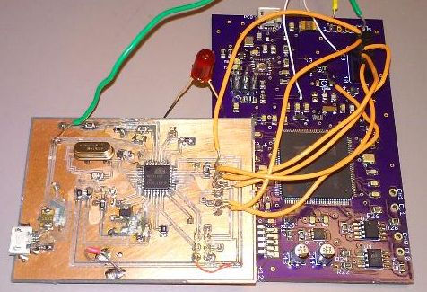

Custom Board Debug
Successfully programmed custom board using programmer breakout board
Board is warm to touch but no issues with functionality have been noticed
Found small issues with signal lines will revise board schematic for a rev. 2
Killed prototyping board
DUE

Slide 3
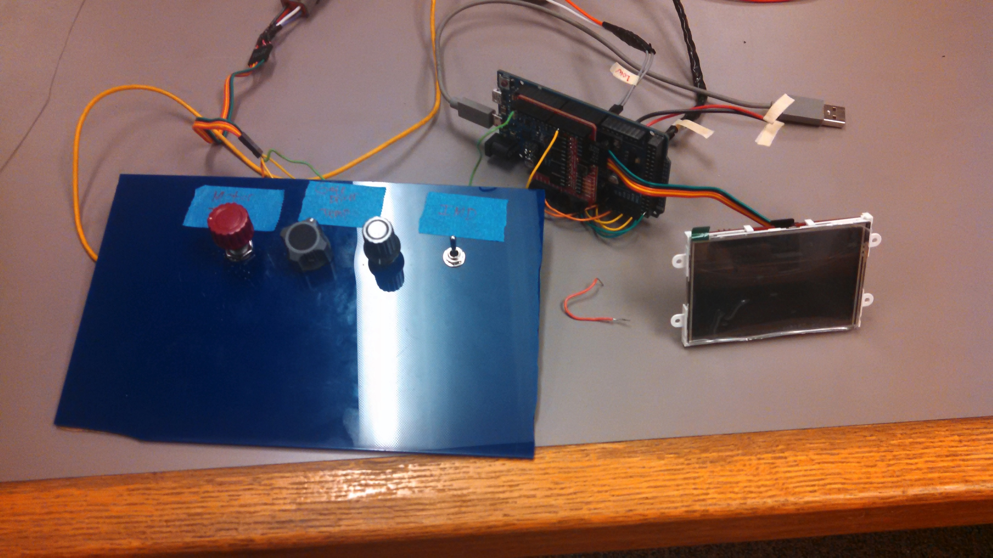
Demo Unit Updates
Custom board is functional and ready to use for presentation
GUI object names need to be updated but everything is being displayed on screen correctly
Clean up layout and look of demo unit for presentation.

Slide 4
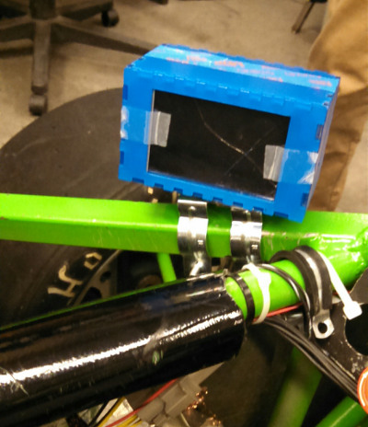
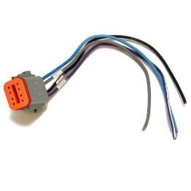
Enclosure Update
Enclosure design finalized
Fabrication has begun
8 Pin Deutsch connector to be used for all wires entering the enclosure

Slide 5
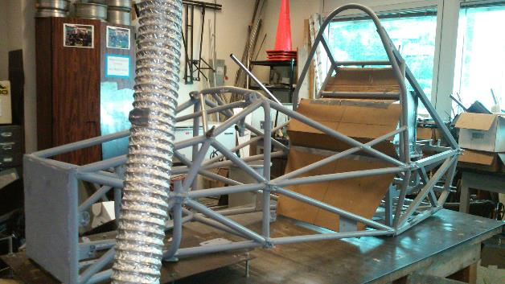
Electric Vehicle Update
In Progress
Suspension hung and motor placed but no secured.
Appears to be on schedule for end of May first week of June completion.

Slide 6
Goals For The Upcoming Week
System
- Create all wire harnesses needed for presentation
- Populate second board with components (back up board)
- Make alterations to board signal lines
Enclosure
- Finish fabrication of enclosure for system.
- Perform water resistance testing on enclosure
Documentation
- Continue polishing/revising report
- Finalize poster and turn in for printing
- Revise all other documentation
Other
- Check in with VMS group to monitor progress
Notes:
6

